Slide 1
Social Security Disability Benefits
Jacob M. Eden, Staff Attorney
eden@aidslawpa.org
AIDS Law Project of PA

Slide 2
Medicaid Review
MAGI
138% FPIG
No resource test
18-64
Use MAGI counting rules
Cannot be eligible for Medicare
Healthy Horizons
100% FPIG*
$2k resource test
Disability (EAF)
(asymptomatic HIV is enough)
Use SSI counting rules
MAWD
250% FPIG*
$10k resource test
Disability (EAF)
(asymptomatic HIV is enough)
Use SSI counting rules
Must have job

Slide 3
Social Security Programs
Title II of the Social Security Act
Social Security Disability Insurance (SSDI)
Social Security Retirement
Widows/Widowers Benefits
Survivor’s Benefits
Dependant’s Benefits
Disabled Adult Child (DAC)
SSD
For people with work history who paid payroll tax
Monthly benefit based on past work history – maximum $3,148, avg. $1,258
Either receive your benefit or you do not
Medicare after 2 years
5 month waiting period from disability onset
Usually paid on the 3rd or on 2nd/3rd/4th Wednesday of the month

Slide 4
Social Security Programs
Title XVI of the Social Security Act
Adult Supplementary Security Income (SSI)
Child Supplementary Security Income (SSI)
SSI:
Needs based program
Maximum benefit of $841 per month in 2022 (plus state supplement)
Sliding scale monthly payments based on income
Comes with Medical Assistance
Available month after disability onset
Paid on the 1st of the month (or a few days before)

Slide 5
Criteria
SSI
SSDI
Non-Medical
Requirements
Medical
Disability
Non-Medical
Requirements

Slide 6
Criteria
Application
(online or in person)
Applicant
Decision
Field Office
SSI
Non-Medical
Requirements
SSD
Non-Medical
Requirements
SSI
SSDI
Non-Medical
Requirements
Medical
Disability
Non-Medical
Requirements
Bureau of Disability Determination
(PA Department of Labor & Industry)
a.k.a. Disability Determination Services (DDS)
Decision
Medical
Disability

Slide 7
Medical Disability

Slide 8
SSA’s definition of Disability
The inability to engage in any substantial gainful activity (SGA) by reason of medically determinable physical and/or mental impairment(s) which can be expected to last for a continuous period of not less than 12 months or result in death.
Same definition for both SSI and SSDI

Slide 9
SSA’s Five-Step Disability Evaluation Process
SSA uses a five-step process, known as the “sequential evaluation process, ” to determine if an applicant is disabled.
Step 1: Is the Claimant engaged in “substantial gainful activity”?
Step 2: Is the applicant’s impairment severe?
Step 3: Does the applicant have a condition that meets or equals the “ Listing of Impairments” ?
Step 4: Can the applicant perform prior employments?
Step 5: Can the applicant perform any job in the national economy?

Slide 10
SSA’s HIV Listing of Impairments for Adults
New Listings effective January 2017
The SSA HIV listing are found under the heading 14.11
Sections A-J deal with specific conditions such as:
A. Multicentric Castleman disease affecting multiple groups of lymph nodes or organs containing lymphoid tissue.
B. Primary central nervous system lymphoma
C. Primary effusion lymphoma
D. Progressive multifocal leukoencephalopathy
E. Pulmonary Kaposi sarcoma
F. Absolute CD4 count of 50 cells/mm3 or less
G. Absolute CD4 count of less than 200 cells/mm3 or CD4 percentage of less than 14 percent, and one of the following (values do not have to be measured on the same date)
BMI measurement of less than 18.5
Hemoglobin measurement of less than 8.0 grams per deciliter
H. Complication(s) of HIV infection requiring at least three hospitalizations within a 12-month period and at least 30 days apart (see 14.00F6). Each hospitalization must last at least 48 hours, including hours in a hospital emergency department immediately before the hospitalization.
I. Repeated manifestations

Slide 11
Criteria
Application
Applicant
Field Office
SSI
Non-Medical
Requirements
SSD
Non-Medical
Requirements
Decision
SSI
SSDI
Bureau of Disability Determination
(PA Department of Labor & Industry)
a.k.a. Disability Determination Services (DDS)
Non-Medical
Requirements
Medical
Disability
Non-Medical
Requirements
Medical
Disability
Decision

Slide 12
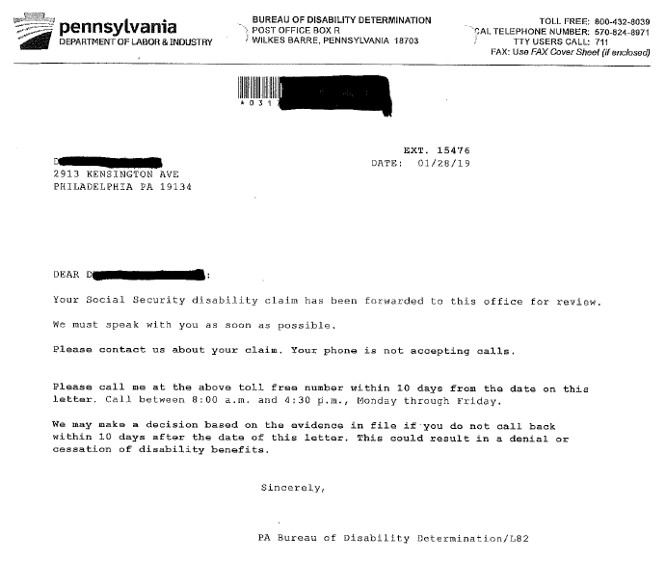
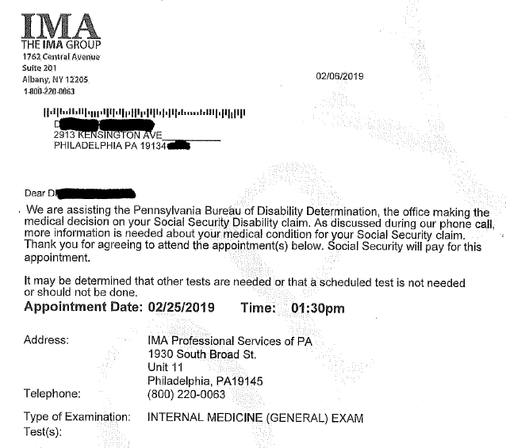

Slide 13
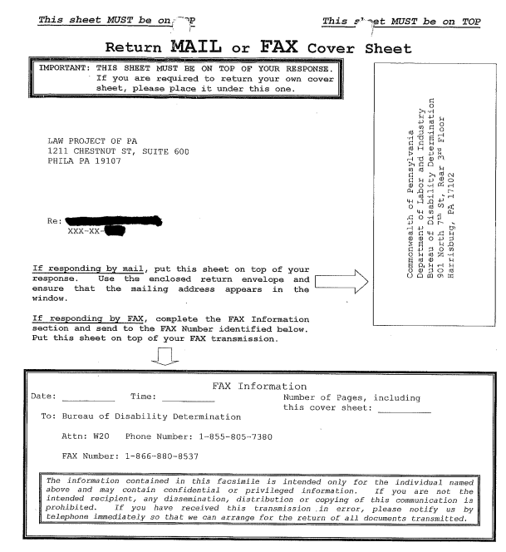
BDD Fax cover sheet –
Use this to send medical records directly to the BDD case file.
More likely to end up in the file this way, then taking files to the Field Office.
Tip: Make a copy before using.

Slide 14
Non-Medical Eligibility

Slide 15
Criteria
SSI
SSDI
Non-Medical
Requirements
Medical
Disability
Non-Medical
Requirements

Slide 16
SSDI
SSDI is a Social Security insurance program that pays a monthly cash benefit to people who are:
Disabled, and
Insured = worked and earned Social Security credits by paying FICA taxes close to disability onset. For most adults, this means working for about 5 of the last 10 years before becoming disabled.
SSDI is not needs-based and has no income or asset limits.
Notes:
SSDI provides payments to workers who have made contributions to the Social Security trust through the Social Security tax on their earnings. SSDI is also available to certain dependents of workers.
Who qualifies? To qualify for SSDI the claimant must fall into a category:
- The Claimant is a disabled insured worker under age 66
Family member of an eligible worker – this is an auxiliary benefit also known as “dependent’s benefits” - This is not the focus of this training, so we will not discuss the various programs related to dependent’s benefits.
Citizenship or Residency Requirements -
- Claimants may receive SSDI payments if they are a US citizen or permanent resident, living in the US or abroad. If the claimant is neither a USC or a permanent resident, that person may still be entitled to receive SSDI if shown to be lawfully present in the US and meet certain other criteria.

Slide 17
SSDI Benefit
Amount: Varies. Based on lifetime earnings.
When does payment start?
Five months after onset of disability (onset is usually the last day of work).
Retroactive benefits possible for 1 year before date of application.
Medicare coverage begins 24 months after start of payment (which is 29 months after onset).

Slide 18
What to do until Medicare?
Before ACA: Most had to depend on COBRA coverage, where a person could continue their employer coverage by paying premium themselves.
Now: Expansion MA! So Medicaid is possible for those under 138% FPL.
The moment person becomes eligible for Medicare, they lose eligibility for Expansion MA…but remember Healthy Horizons and MAWD.

Slide 19
SSI Non-Medical Requirements
“Needs-based” program
Disabled
Income Limitations – Countable income less than the maximum ($841 in 2022) SSI payable to that individual.
Resource Limitations – Countable resources of less than $2,000 for an individual and $3,000 for a married couple.
Notes:
Non-medical requirements for SSI eligibility
1. applicant’s income
Receiving a substantial sum of money (legal claim, viatical settlement, inheritance) can affect eligibility for SSI and other means-tested benefits.
Viatical settlements grew in popularity in the United States in the late 1980s, when the AIDS epidemic peaked.^{[3]} The early victims of AIDS in the U.S. were largely gay men, many of whom were not particularly old. They often had no wives or children (the traditionalbeneficiaries under a life insurance policy), but they had life insurance policies through employment or as a result of investments. The beneficiaries under the policies were often their parents who did not need the money. Viatical settlements offered a way to extract value from the policy while the policy owner was still alive.

Slide 20
SSI Income Limitations
Income – Generally, SSA counts as income anything a person receives that can be used for food and shelter.
SSA categorizes income as either earned or unearned
Earned income includes wages, net earnings from self-employment, royalties, honoraria for services rendered.
Unearned income includes worker’s compensation, disability benefits, veteran benefits, pension and retirement payments.

Slide 21
SSI Income Counting Rules
To determine Countable Income:
CI = UI + EI
Unearned income (UI)
$$$ - $20 general disregard
Earned income (EI)
$$$ - $65 (earned income disregard) divided by HALF
Example:
Bob receives $500/month from his aunt and $465/month from his job. What is his COUNTABLE income?

Slide 22
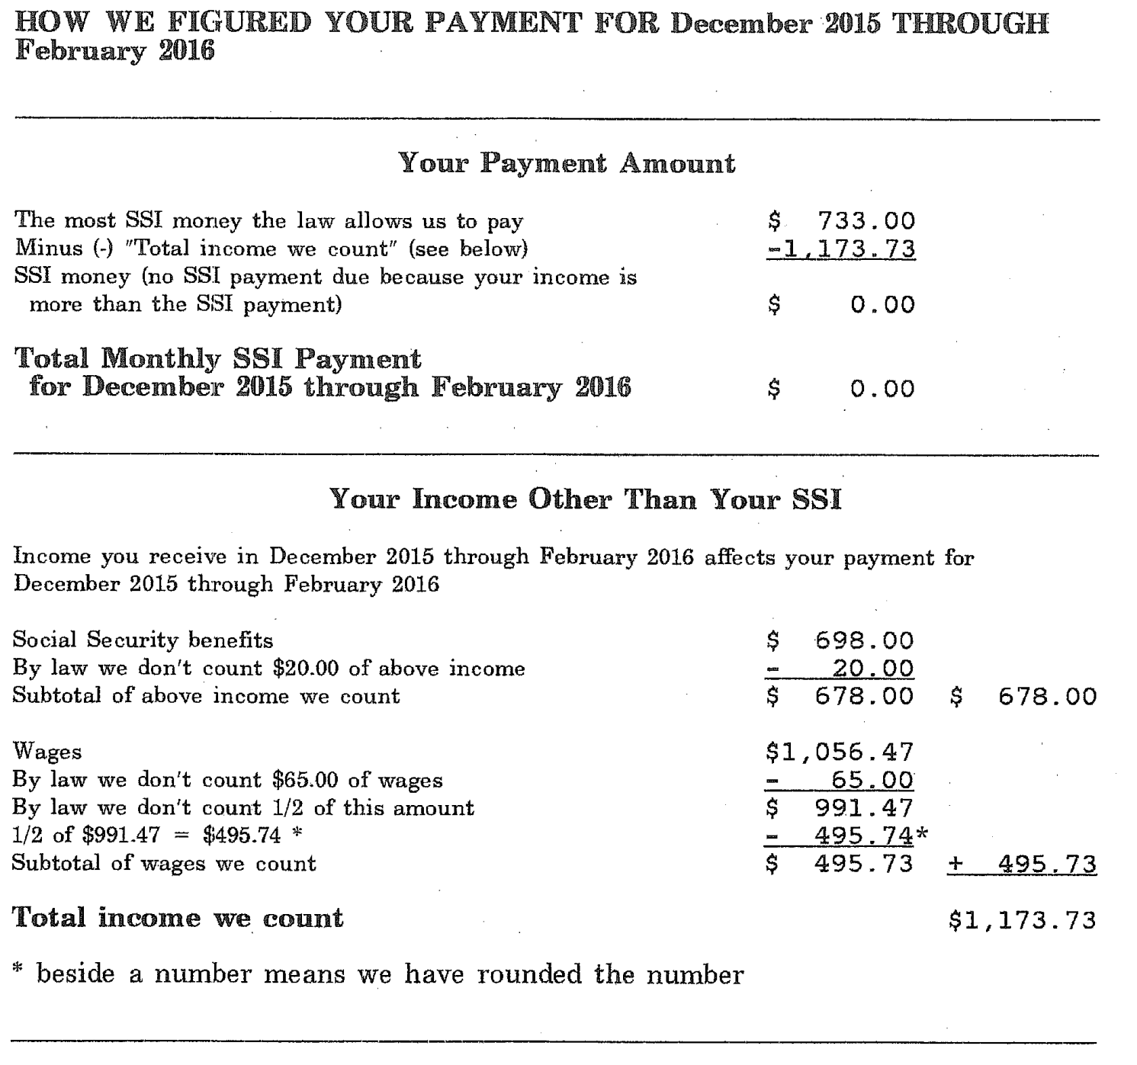
Unearned (SSDI)
Earned (Wages)

Slide 23
SSI Program
Payments begin from date of application, no retroactive benefits past application date.
SSI pays a monthly cash benefit depending upon the recipient’s household. Generally, SSI recipients receive up to $841 + SSP of $22.10 = $ 863.10
SSI will not pay a disabled person monthly cash benefits if recipient’s household countable income surpasses SSI’s amount of $841.
In PA & NJ, automatically enrolled in Medicaid.
Notes:
In the afternoon portion, Jacob will explain how to calculate benefit amount for SSI recipient who are working or have adults working in the household.

Slide 24
Concurrent Benefits
Can a person receive both SSI and SSDI?
For example: If a person receives a payment of $300 in SSDI, and meets other requirements (like resources), they will receive an SSI payment to make up the difference between the FBR amount ($841) and the SSDI amount.
SSDI is unearned income; So if Bob has SSDI of $300, his UI is $280 ($300 - $20 disregard). Assuming no other income, his countable income is the same. Subtract CI from FBR ($841 - $280) for SSI payment ($561)
Dual eligibles receive both Medicaid and Medicare – and remember SPBP for any extra prescription costs.

Slide 25
Telling the Difference BTW SSI & SSDI
SSDI
SSI
3rd of the month?
Medicare (RWB card)?
More than $841 per month?
1st of the month?
Medical Assistance?
$841 or less?

Slide 26
Appeals
Applications denied for medical reasons
Reconsideration (New)
Chance to submit additional medical records and/or attend any missed consultative exams.
Hearing w/Administrative Law Judge
(This is the system that has always been in place for non-application issues)
Application
Request for Reconsideration
(Form SSA-561 or online)
Request for Hearing by Administrative Law Judge
(Form HA-501-U5 or online)

Slide 27
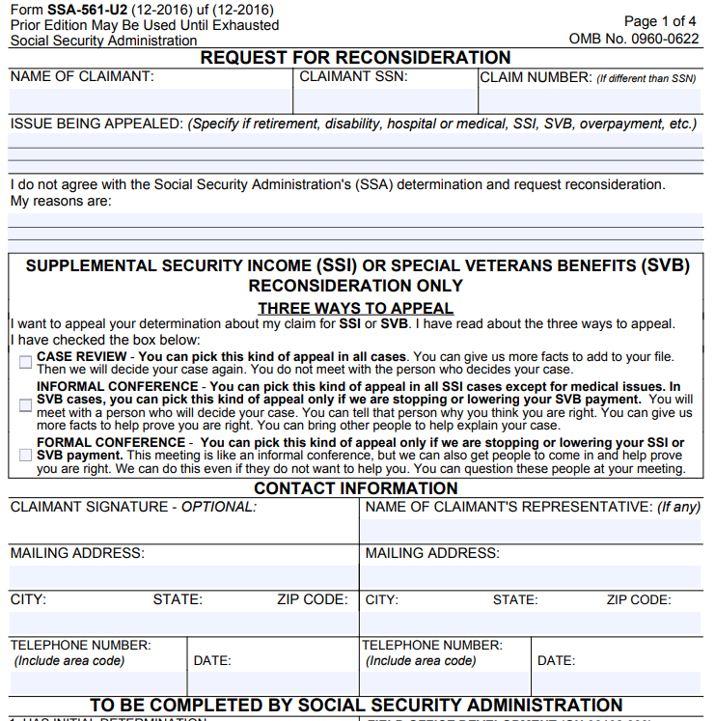
Form SSA-561-U2

Slide 28
Social Security Post Entitlement
Jacob M. Eden, Esq.
eden@aidslawpa.org
AIDS Law Project of Pennsylvania
1211 Chestnut Street, Suite 600
Philadelphia, PA 19107
(215) 587-9377

Slide 29
Post Entitlement
Periodic Reviews:
Redeterminations – SSI only
Continuing Disability Reviews – SSI & SSDI
Back to Work
Overpayments

Slide 30
Redetermination

Slide 31
Redetermination (RZ)
SSI only
Scheduled RZs: Every 1 – 6 years, SSA reviews an SSI beneficiary’s non-medical eligibility for benefits.
Income
Resources
Living Arrangement
Unscheduled RZs: Information reported to SSA can trigger an RZ

Slide 32
Redetermination (RZ)
Initiated via letter
Should say “Notice of Appointment” in top left corner, but more likely will say “Important Information”
“This is a very important letter about keeping your Supplemental Security Income (SSI) case active. Please read it carefully.”
There will also be a “things we need for the appointment” section.

Slide 33
Redetermination (RZ)
Clients should respond to these letters!
Usually routine and there will be no issues
Encourage clients to respond
Help them gather the necessary documents if you can
Have clients contact AIDS Law Project if you think there is any type of problem!
When clients meet with SSA for an RZ, they should be given a write up of the information they provided. Keep this!
Meetings can result in “Notice of Change in Benefits” letters

Slide 34
Redetermination (RZ) Appeals
Be on the lookout for any notices
APPEAL IMMEDIATELY if any changes
Client only has 10 days to appeal and keep benefits going as they were (really 15 days).
Appeal deadline is 60 days
Get receipt of appeal and contact AIDS Law Project ASAP

Slide 35
Form SSA-561-U2

Slide 36
SSI Suspension, Stop Payments and Terminations

Slide 37
Suspension and Stop Payment
SSI Suspensions can happened for several reasons:
Excess income
Excess resources
Incarceration
Resident of public institution
Absence from the United States
Fleeing Felon
Whereabouts Unknown
To end suspension, demonstrate to SSA issue resolved
There are also interruptions in payments, called “Stop Payments” – Beneficiary remains eligible
SSA looking for Representative Payee
Person’s wages above income limit but remains eligible via 1619(b)

Slide 38
Terminations
Death
No longer disabled
Voluntary termination
Suspensions that have lasted more than 12 months

Slide 39
Common Scenario
Client wins a settlement, the lottery, or some other large one time payment
The month it comes in, the money counts as income
The following month, whatever money remains counts as a resource.
Ideally, spend down to $2,000 or less as quickly as possible
Cannot give it away or have someone else “hold it”
Can use to pay down debt, buy new home or personal items.
Keep complete records of where the money goes; without clients may be subject to a period of eligibility for up to 36 months.
(Call ALPP – we help people through the process)

Slide 40
Continuing Disability Review

Slide 41
Continuing Disability Review (CDRs)
SSA periodically reviews medical eligibility
“Medical Improvement Review Standard” MIRS
Easier standard to meet than during application process – but more complicated (8-step sequential process!)
Compares current impairments to those of application (or the last CDR)
Try to find out what the prior impairments were and make sure to address in CDR forms
More intense review than a redetermination
Have to fill out multiple forms about current doctors and current daily activities.
Similar to application
Need medical records

Slide 42
CDR
Over 90% of adults who have CDRs continue benefits
Until recently, SSA infrequently performed CDRs on people with HIV
Now, we are starting to see more CDRs
The SSA has recently changed its policy on deferring CDRs for people who meet HIV listing. This means people who have been on SSI or SSDI benefits for decades are now having CDRs for the first time.

Slide 43
CDR
CDR Process:
Notice of CDR
Respond! Complete the requested forms and attend any requested meetings.
Failure to respond will lead to termination!
Two types of CDR:
“Short form” : SSA-455-OCR-SM - machine readable, used to decide if full medical review necessary
Full Review

Slide 44
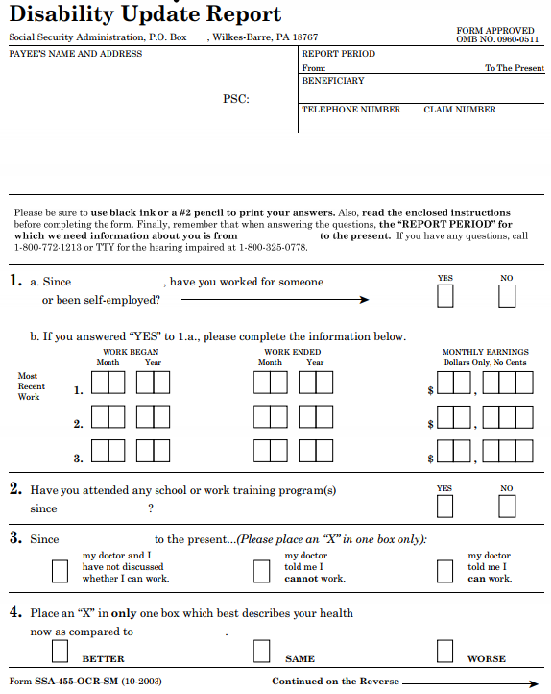
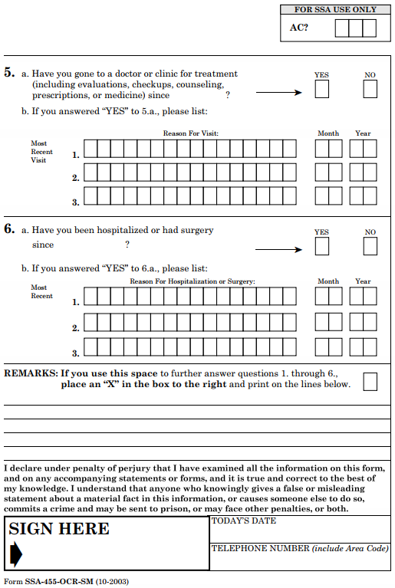
Short Form

Slide 45
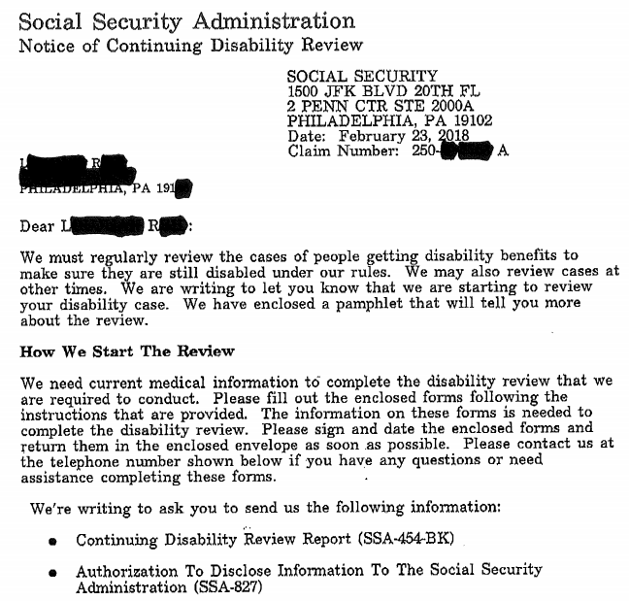
Regular/Full CDR

Slide 46
CDR
Notice of Disability Cessation (or Continuation)
Appeal IMMEDIATELY – if appeal within 10 days, person gets benefits while the appeal is being decided. Appealing in person is best because need signed form to continue benefits.
Use a special Request for Reconsideration form (or whatever form the notice says to use) – Form SSA 789
Appeal is before a Hearing Officer – less formal than an ALJ

Slide 47
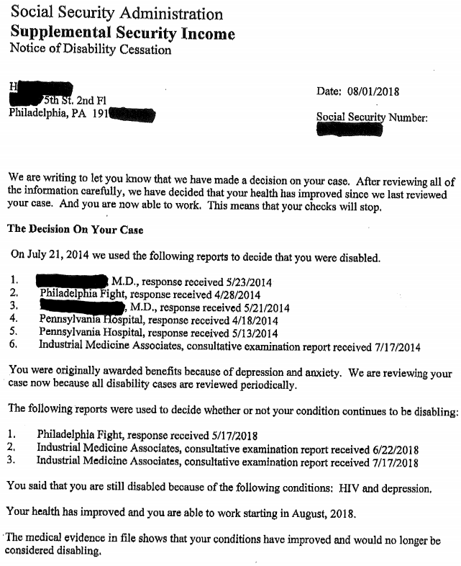
Original Medical Records
CDR Medical Records

Slide 48
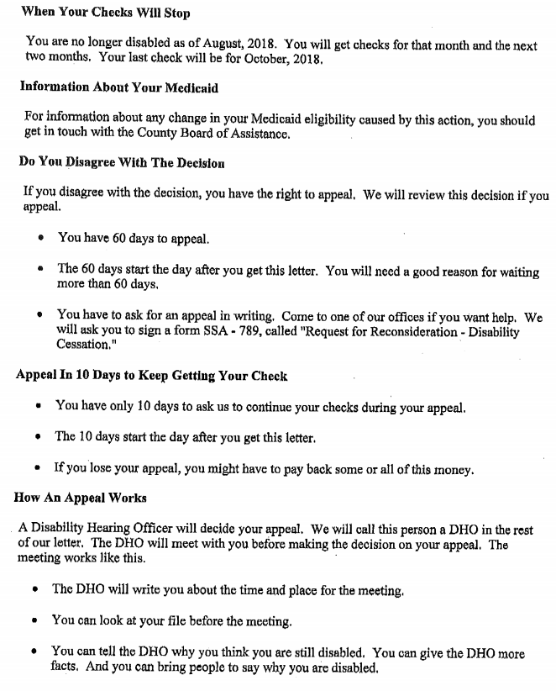
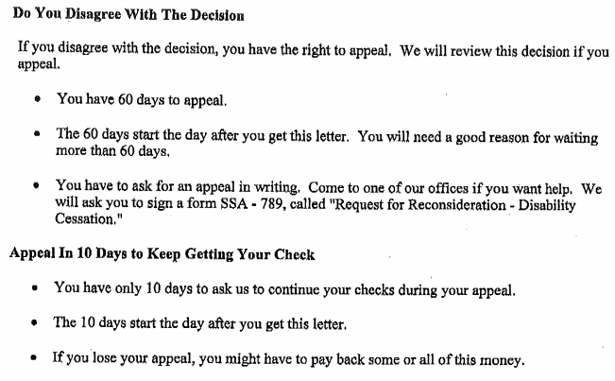

Slide 49
CDR
CDR Process Continued
Notice of Reconsideration
If not favorable, appeal IMMEDIATELY – if appeal within 10 days, person gets benefits while the appeal is being decided. Appealing in person is best because need signed form to continue benefits.
Use the Request for Hearing form
HA-501(aka SSA-501)
The case will go to an Administrative Law Judge
During all phases of the process, the beneficiary can supply additional medical information to support claim.

Slide 50
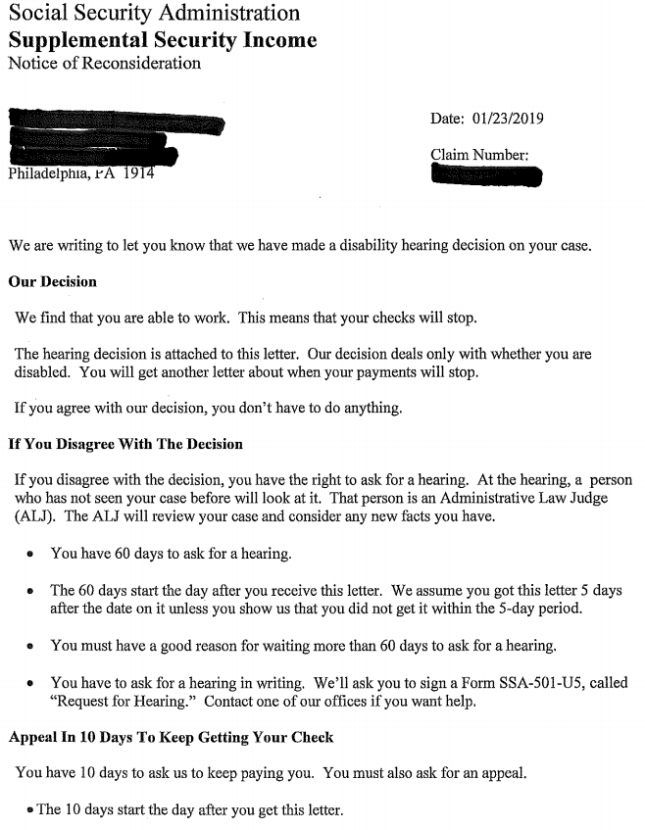
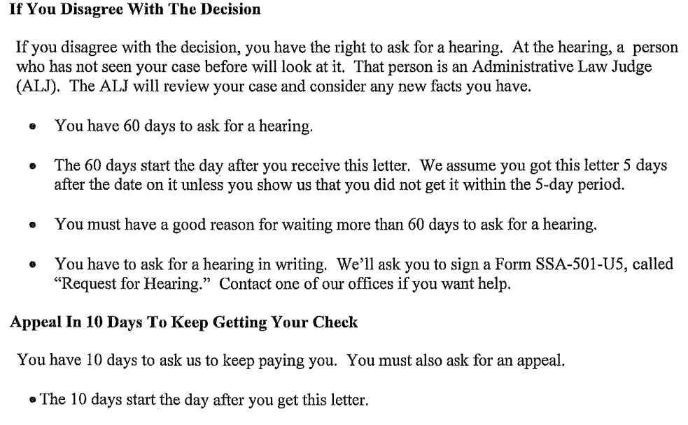

Slide 51
CDR Tips
Even after approval for SSI or SSD, encourage clients to stay in treatment
Medical records are crucial for CDRs. Just like in the initial application, Social Security wants to see medically documented impairments.
When filling out forms, use same principles as application
Keep in mind the prior impairments
Beneficiary can call AIDS Law Project when they receive the initial CDR notice.

